Slide 1
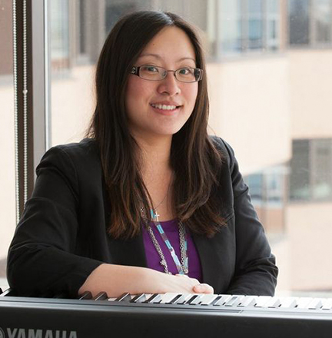
 | Kiki Chang (she/her) Training Coordinator
 | Working in health care as a music therapist for 12+ years
 | Background in higher education as a Teaching Assistant and Course Director
 | Interest in inclusive and accessible pedagogy, and universal design in education
 | Education Coordinator at PeerWorks
 | Lives in Vancouver, BC Kiki@peerworks.ca
Notes:
TRAINER
“Next thing we’d like to do today is get to know everyone.”
At this point, as the trainer, introduce yourself and what you would like to share about your experience with Peer Support. The slide will show a picture of you, along with some facts that you want to share with the participants.
Note: this slide will be updated with the trainer’s photo and bio.

Slide 2
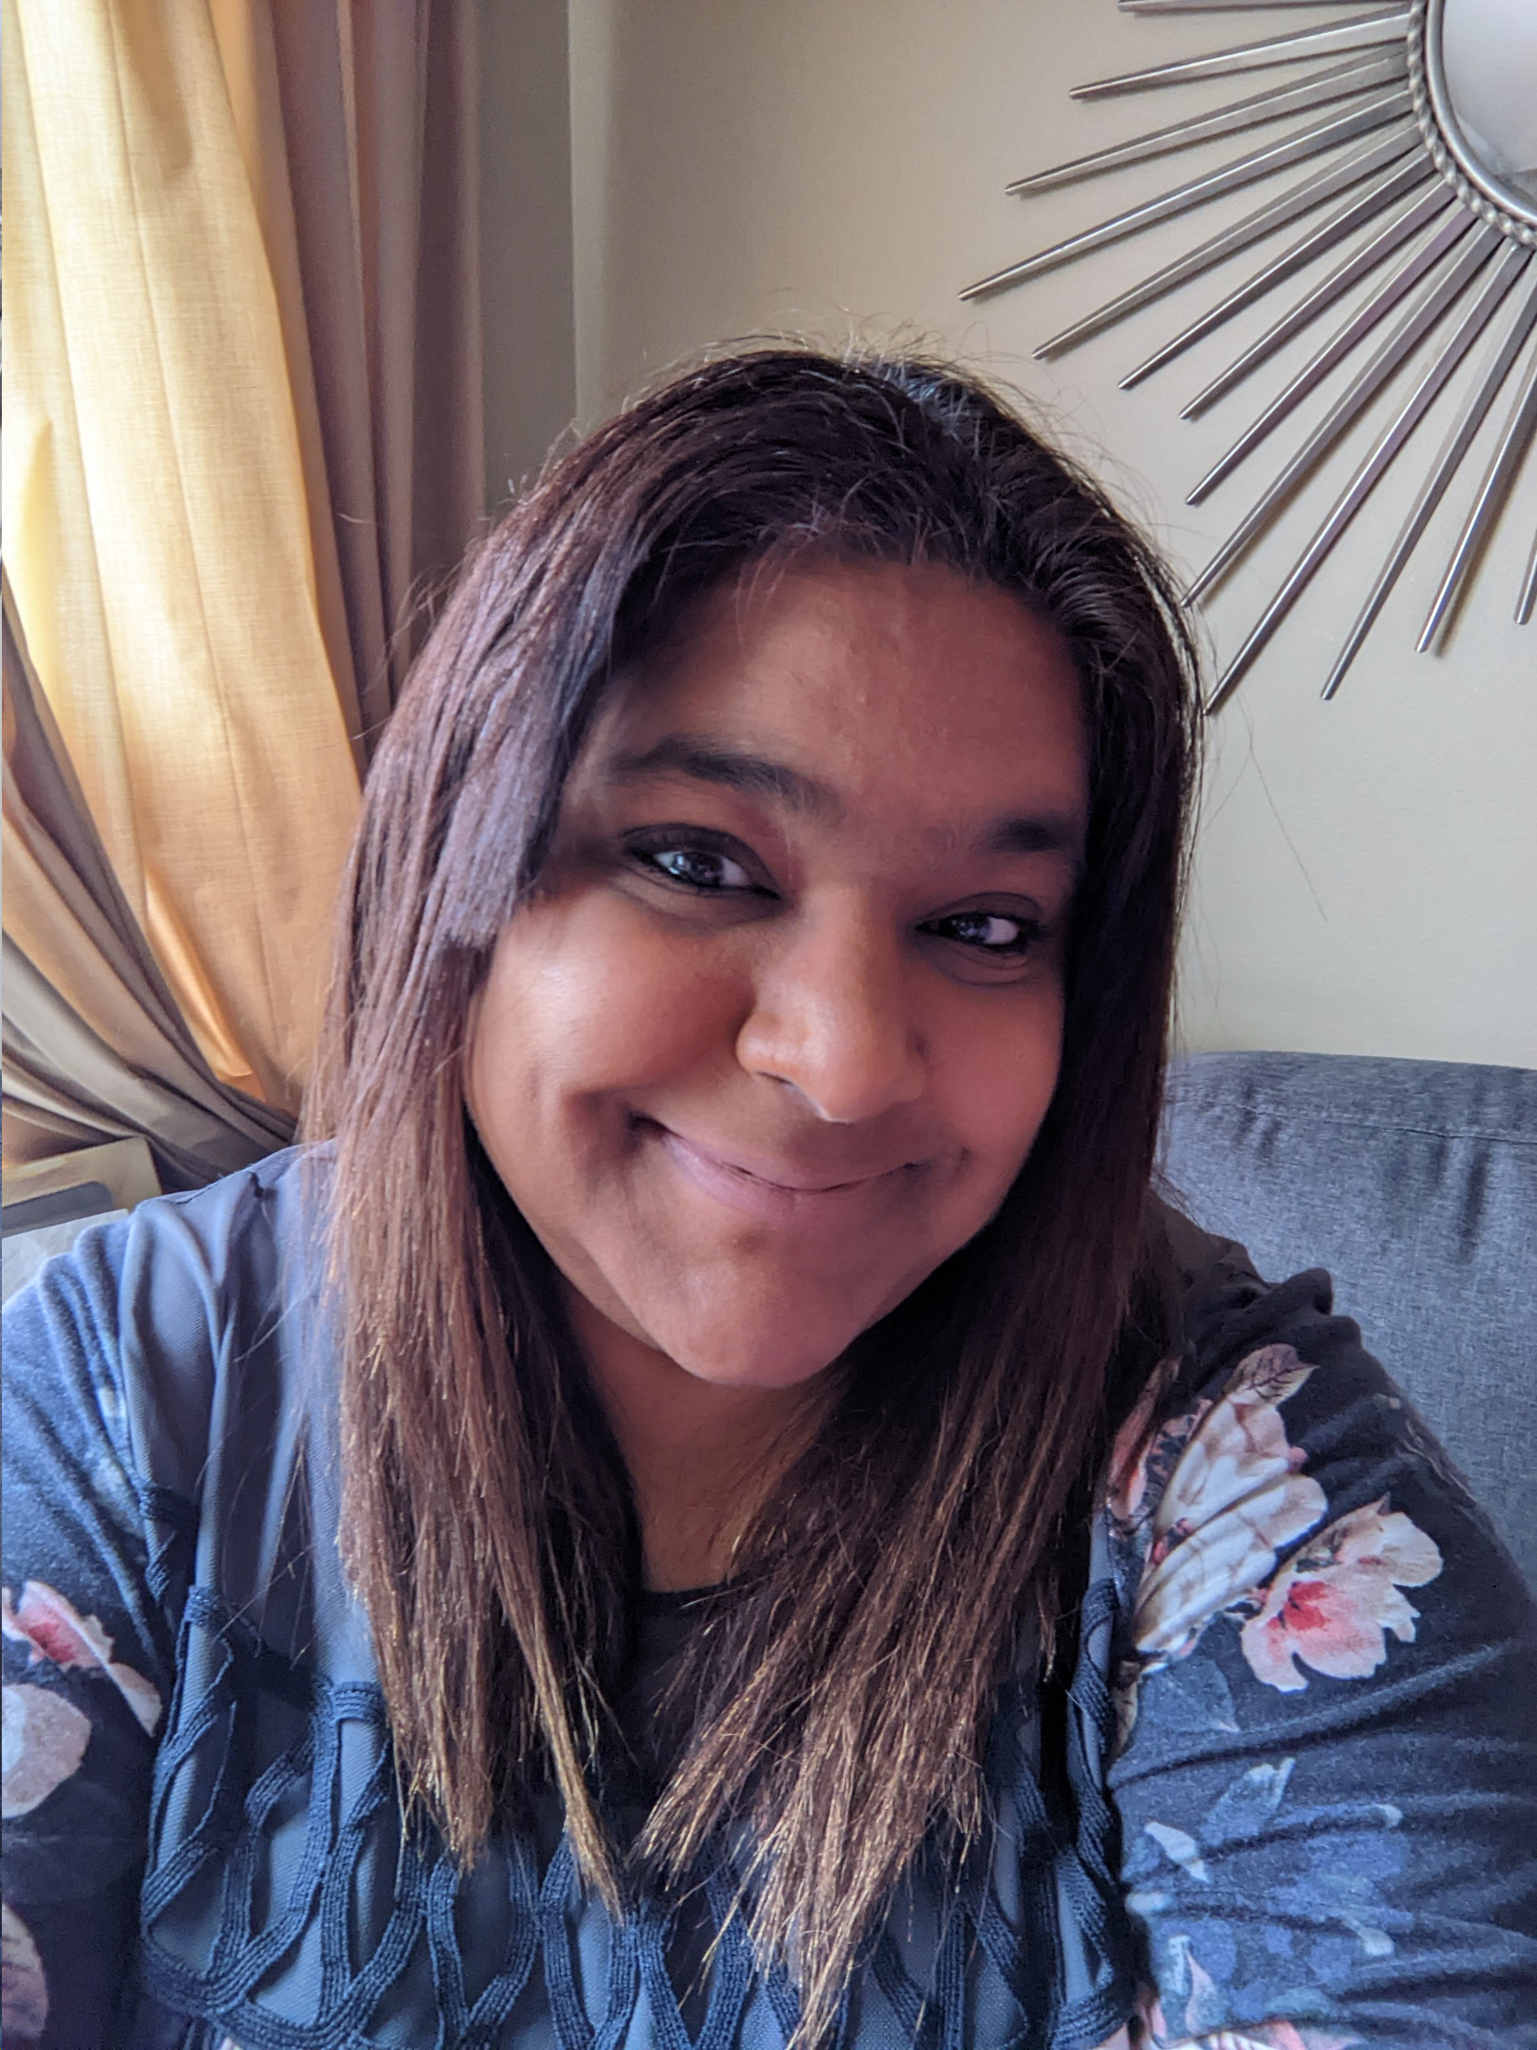
 | Zebina Virji (she/her) Training Coordinator
 | Working in mental health for 10+ years as a Peer Supporter and Community Support Worker in a Consumer Survivor Initiative and in a Peer Support Organization - CMHA
 | PeerWorks Core Essentials and Certified Peer Supporter from Peer Support Canada
 | WRAP 2 Facilitator Living Life to the Full Facilitator Registered Social Service Worker RSSW
 | Administrative Coordinator at PeerWorks
 | Lives in Toronto, ON, CA zebinia@peerworks.ca
Notes:
TRAINER
“Next thing we’d like to do today is get to know everyone.”
At this point, as the trainer, introduce yourself and what you would like to share about your experience with Peer Support. The slide will show a picture of you, along with some facts that you want to share with the participants.
Note: this slide will be updated with the trainer’s photo and bio.

Slide 3
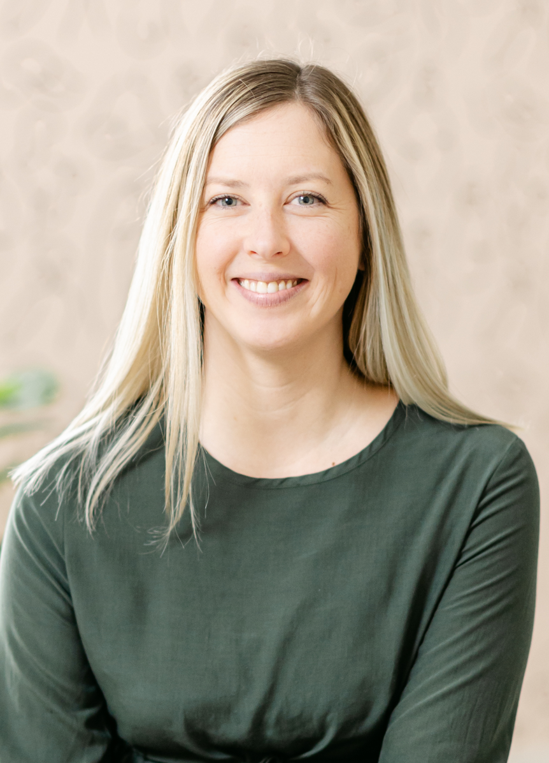
 | Karin Thoms (she/her) Training Coordinator
 | Former Human Resources Generalist for 10+ years; Peer Support Program Manager at Perinatal Wellbeing Ontario; Customer Care and Peer Supporter at The WOMB Woodstock
 | PeerWorks Core Essentials Certified Peer Support Worker
 | Perinatal Mental Health Advocate and Peer Supporter; Peer Support Volunteer at the PAIL Network; Social Service Worker student at Durham College; Client Care Coordinator at Cambrian Counselling and Wellness
 | Training Coordinator at PeerWorks
 | Lives in Paris, ON karin@peerworks.ca

Slide 4
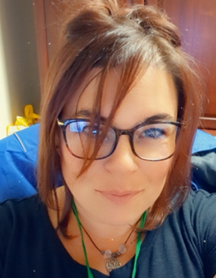
Darcey Lachapelle (she/her) Trainer
Former Early Childhood Educator for 10 years
Mental Health and Addictions Graduate
Support Services Counsellor, True Self- Debwewendizwin
PeerWorks Core Essentials Certified Peer Supporter and Trainer
Lives in North Bay, ON
Notes:
TRAINER
“Next thing we’d like to do today is get to know everyone.”
At this point, as the trainer, introduce yourself and what you would like to share about your experience with Peer Support. The slide will show a picture of you, along with some facts that you want to share with the participants.
Note: this slide will be updated with the trainer’s photo and bio.

Slide 5
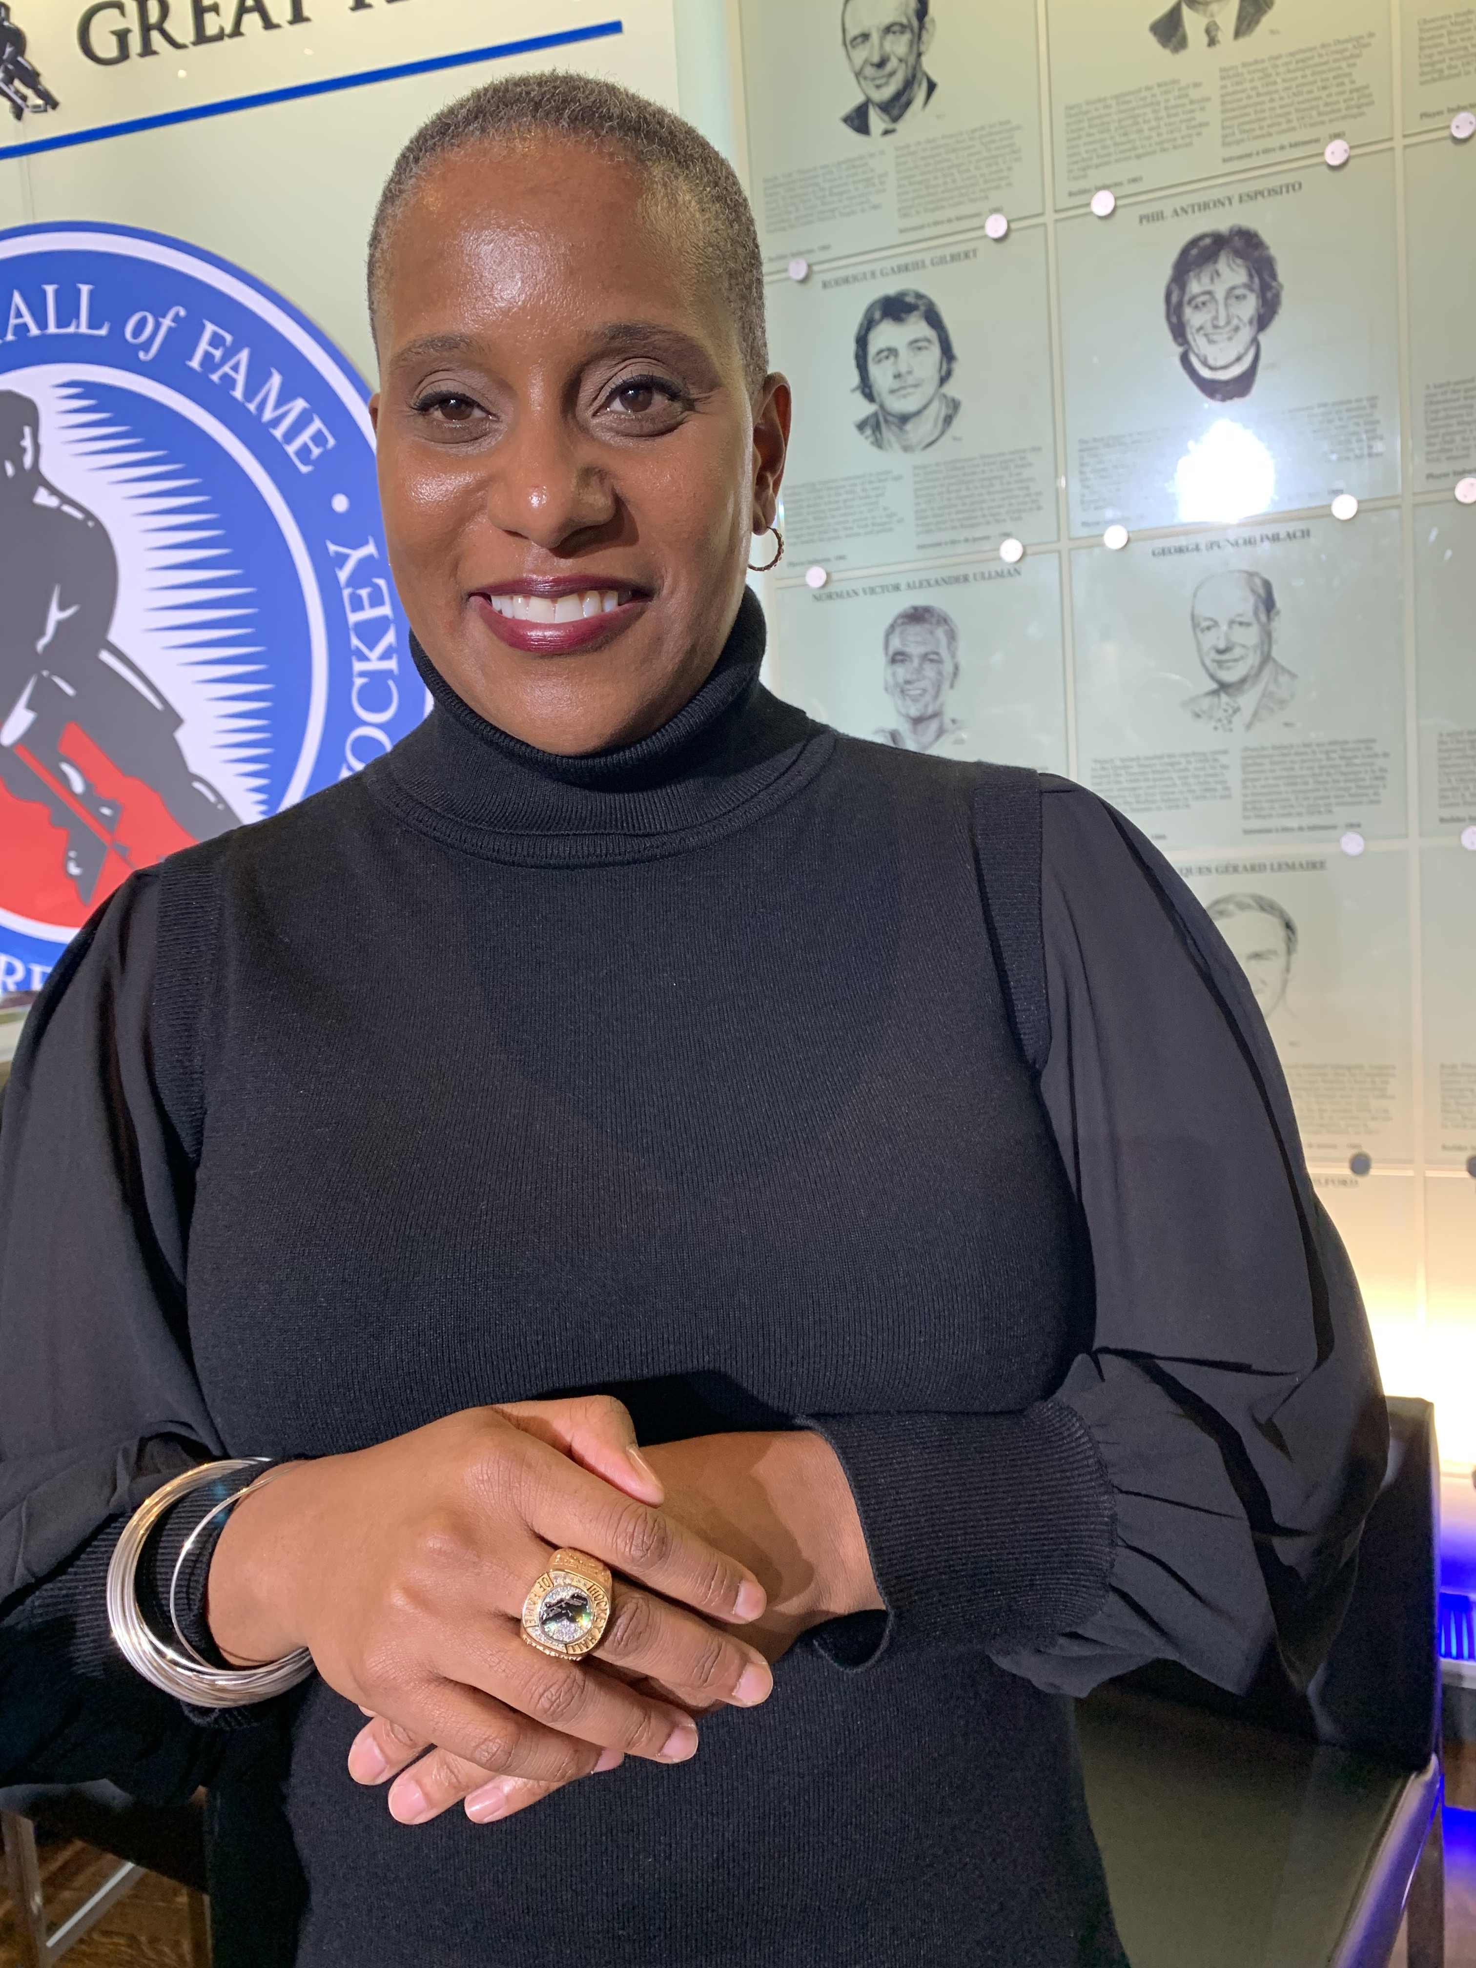
Brooke Chambers (she/her)​ Trainer
​
Former advisory group member to the Federal Minister of Health, Professional Financial Planner (PFP) and police officer
PeerWorks Core Essentials Certified Peer Supporter and Trainer​
WRAP Facilitator Disabilities Studies Student at MTU
Mental Health Consultant for Public Health Agency Canada's Working Group for the Mental Health of Black Canadians Storyteller and peer supporter for the Carnegie Initiative
From Whitby ON, CA ​
Notes:
TRAINER
“Next thing we’d like to do today is get to know everyone.”
At this point, as the trainer, introduce yourself and what you would like to share about your experience with Peer Support. The slide will show a picture of you, along with some facts that you want to share with the participants.
Note: this slide will be updated with the trainer’s photo and bio.

Slide 6
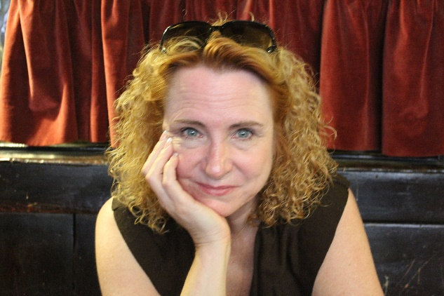
Deborrah (Deb) Sherman (she/her)​ Trainer​
​
Involved in peer support since 2000​
PeerWorks Core Essentials Certified Peer Supporter and Trainer​ ​
Certified Peer Supporter & Certified Mentor, Peer Support Canada​
Former ED of Mental Health Rights Coalition & retired as ED of OPDI​ (aka PeerWorks)
Lives in Hamilton​ ​
Notes:
TRAINER
“Next thing we’d like to do today is get to know everyone.”
At this point, as the trainer, introduce yourself and what you would like to share about your experience with Peer Support. The slide will show a picture of you, along with some facts that you want to share with the participants.
Note: this slide will be updated with the trainer’s photo and bio.

Slide 7
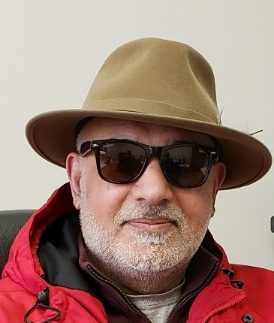
Arif Majeed (he/him) Trainer
Been involved in peer support for over 27 years
OPDI Core Essentials Certified Peer Supporter and Trainer
Peer Support Canada Certified
Started working with “People for Equal Partnership in Mental Health-PEP” and consumer-run peers support and drop-in centre in North Bay, now manager of Peer Support Services Canadian Mental Health Association, North Bay, and District.
Lives in North Bay, ON

Slide 8
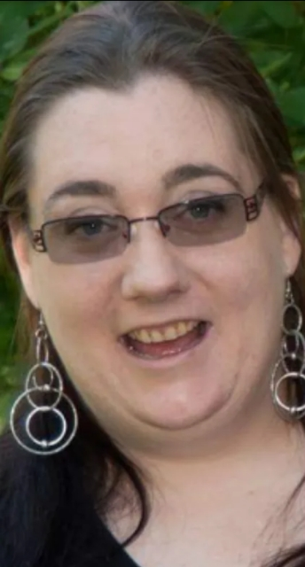
Nicole Parker (she/her) Trainer | Zebina Virji (she/her) Training Coordinator
Been involved in peer support since 2005 | Working in mental health for 10+ years as a Peer Supporter and Community Support Worker in a Consumer Survivor Initiative and in a Peer Support Organization - CMHA
OPDI Core Essentials Certified Peer Supporter and Trainer | PeerWorks Core Essentials and Certified Peer Supporter from Peer Support Canada
Peer Support Canada Certified | Advance Level Facilitator WRAP Living Life to the Full Facilitator Social Service Worker SSW
Began journey of peer support at Waypoint, now working at CMHA York Region | Administrative Coordinator at PeerWorks
Lives in Hillsdale | Lives in Toronto, ON, CA zebinia@peerworks.ca

Slide 9
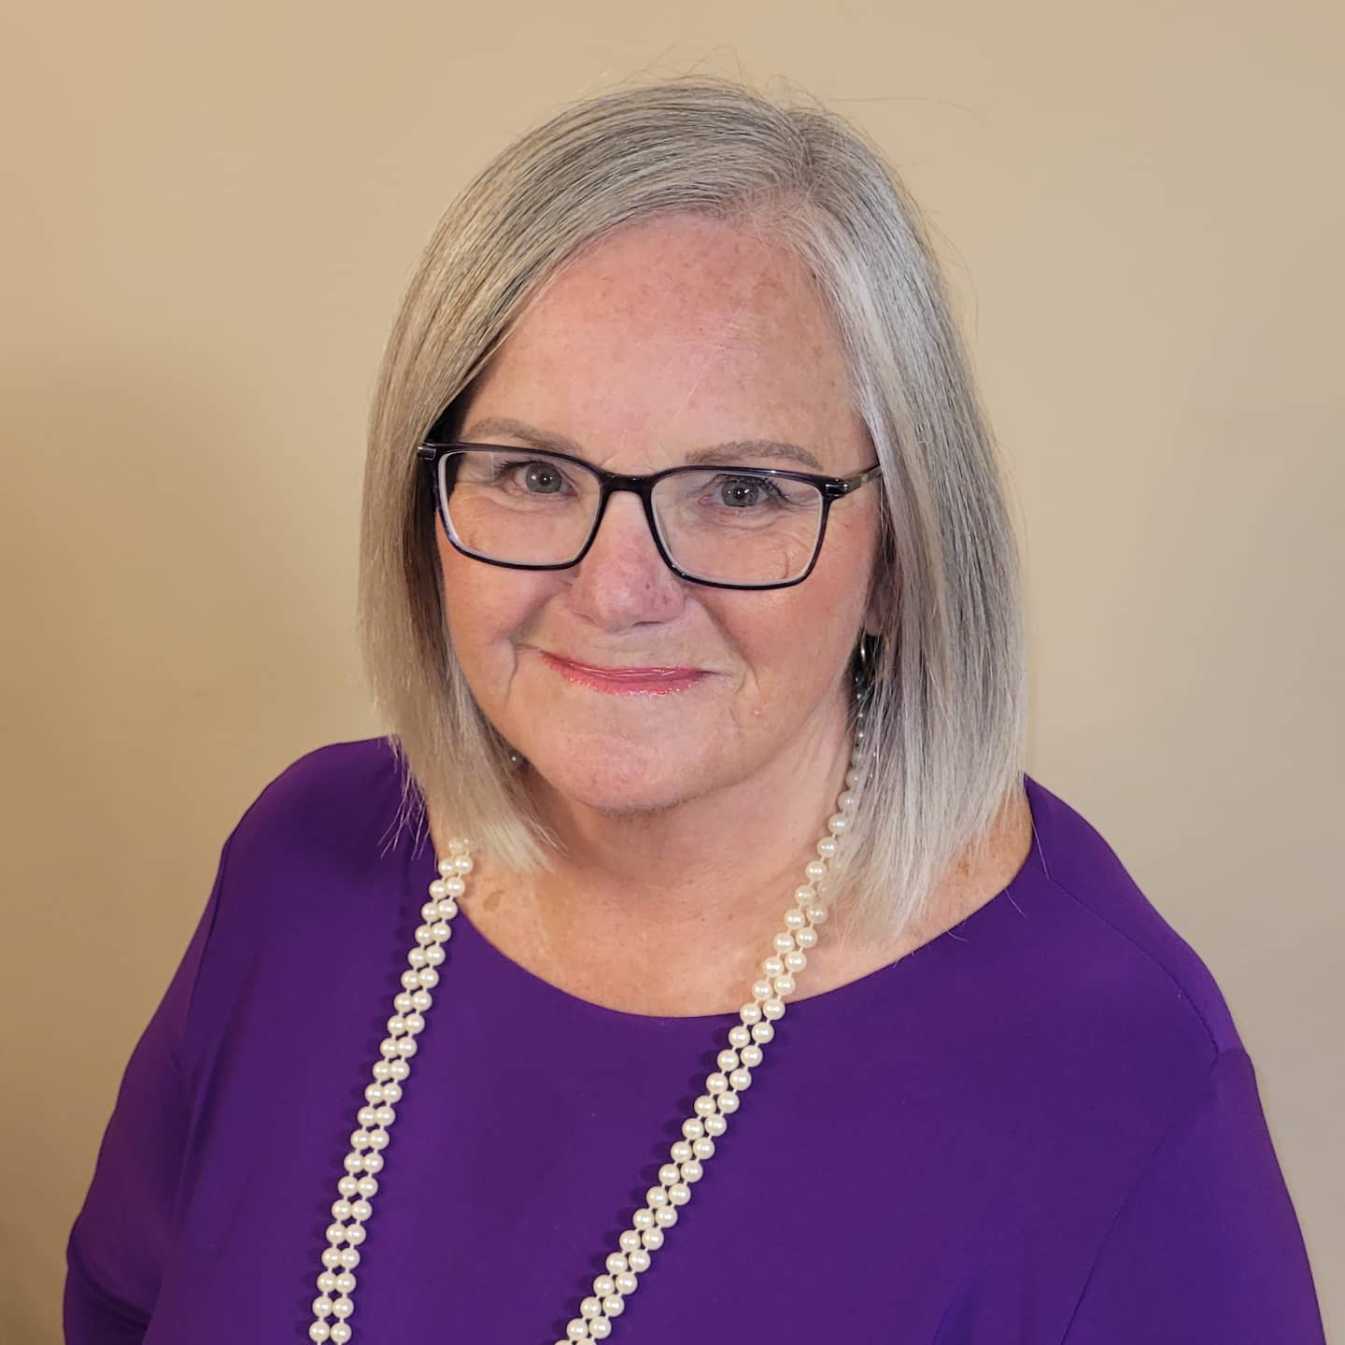
Barbara Frampton (she/her) Trainer
Involved in peer support for 25+ years
OPDI Core Essentials Certified Peer Supporter and Trainer
Peer Support Canada Certified Advanced Level WRAP Facilitator International Peer Zone Facilitator
Former Regional Director, SWAN Past Manager OPDI, Independent Consultant and Trainer
Lives in Aylmer, ON

